Slide 1
TOPIC B2:
PROGRAMMING
LESSON B2-9
ALGORITHM EFFICIENCY

Slide 2
AGENDA
Big O Notation
Time Complexity
Space Complexity
Selecting Algorithms based on efficiency
NOTE!
Have a way to take notes and a way to write code available for this lesson

Slide 3

THE WARM UP QUESTION
Write a program that simulates the line at a theme park ride
Three people should come to the line, then the first person gets to ride
Print out who’s still in line at the end of this

Slide 4
THE WARM UP ANSWER
queue = [] queue.append("Tommy") queue.append("Jommy") queue.append("Bommy") queue.pop(0) print(queue)

Slide 5
BIG O NOTATION
In this world we live in, everything is always about efficiency
How quickly can I finish my homework?
How little work can I do and still get a good grade?
How little effort can I put into a product before releasing it?
How quickly will Game Freak release the next Pokemon game?

Slide 6
BIG O NOTATION
In computer science, we do this with algorithms
We analyze time and space efficiency.
Time efficiency analyses how many steps an algorithm takes to completion
Space efficiency analyses how much memory an algorithm takes to run

Slide 7
TIME COMPLEXITY
Consider the following code
How many times will each of these loops repeat?
for i in range (0, 5): print("Bazinga") for i in range(0 ,20): print("Twentyzinga")
n = int(input("Enter a number")) for i in range(0, n): print(i)

Slide 8
TIME COMPLEXITY
Any number could go in place of the 5 or the 20
The loop will go for whatever number is placed there
What if we were to place a variable in that position?
We describe this loop as running for n number of times
This is written as O(n)
Hence, Big O notation
for i in range (0, 5): print("Bazinga") for i in range(0 ,20): print("Twentyzinga")
n = int(input("Enter a number")) for i in range(0, n): print(i)

Slide 9
TIME COMPLEXITY
What about in this case?
How many times will the message get printed out?
How many numbers will be printed out in the bottom example?
n = int(input("Enter a number"))
for i in range(n , n): for j in range(0 ,5): print("Bazinga") for i in range(1, 11): for j in range(1, 11): print(i * j)

Slide 10
TIME COMPLEXITY
We can’t guarantee what numbers are placed into these loops
In theory, they could be any number, n
So, because for each outer loop, the inner loop has to run, we have n * n number of loops
This leads to O(n²)
n = int(input("Enter a number"))
for i in range(0 , n): for j in range(0 ,n): print("Bazinga") for i in range(1, 11): for j in range(1, 11): print(i * j)

Slide 11
TIME COMPLEXITY
How many repetitions of the loop do we have here
n * (n+3) = n² + 3n
In Big O notation, anything past the largest term is ignored
So, even though there are n² + 3n iterations, the Big O is still O(n²)
Only the term with the highest exponent is used
n = int(input("Enter a number")) for i in range(0,n): for j in range(0, n+3): print("WOAH!")

Slide 12
TIME COMPLEXITY
How about here?
for i in range(0,5): print(i) for i in range(0,5): print(i)

Slide 13
TIME COMPLEXITY
You might think this would be O(2n)
The program loops 2 * n times
However, we ignore coefficients as well as lower order factors in big O
So, this is still O(n)
This is because the class of the algorithm is much more indicative of performance compared to coefficients
for i in range(0,5): print(i) for i in range(0,5): print(i)

Slide 14
TIME COMPLEXITY
An algorithm that loops n + 3 times will always only have a difference of three
100 vs 103 isn’t a huge difference to efficiency
But, n is quite different than n²
We’re looking at 100 vs 10000

Slide 15
TIME COMPLEXITY
What Big O are the following loops?
for i in range(0, 5): print("Test") for i in range(0, n): for j in range(0, 10): print("Test") for i in range(0, n + 5): for j in range(0, n+2): for k in range(0, n): print("Test")

Slide 16
TIME COMPLEXITY
What about the following code?
var = int(input("Enter a number")) print(50 + var)

Slide 17
TIME COMPLEXITY
Regardless of the input value here, the program will run the same number of times
This is called constant time and is represented by Big O notation O(1)
var = int(input("Enter a number")) print(50 + var)

Slide 18
TIME COMPLEXITY
O(1) – Constant time: fixed number of operations; time taken does not depend on anything
O(n) – Linear time: time scales linearly with size of input, think looking through a list, one by one, for an item
O(n²) – Quadratic time: time taken is proportional to the square of the input size

Slide 19
TIME COMPLEXITY
O(2^{n}) – Exponential time: The algorithm’s run time doubles for each new thing added to the
O(log n) – Logarithmic time: time scales logarithmically with the increase in input size.

Slide 20
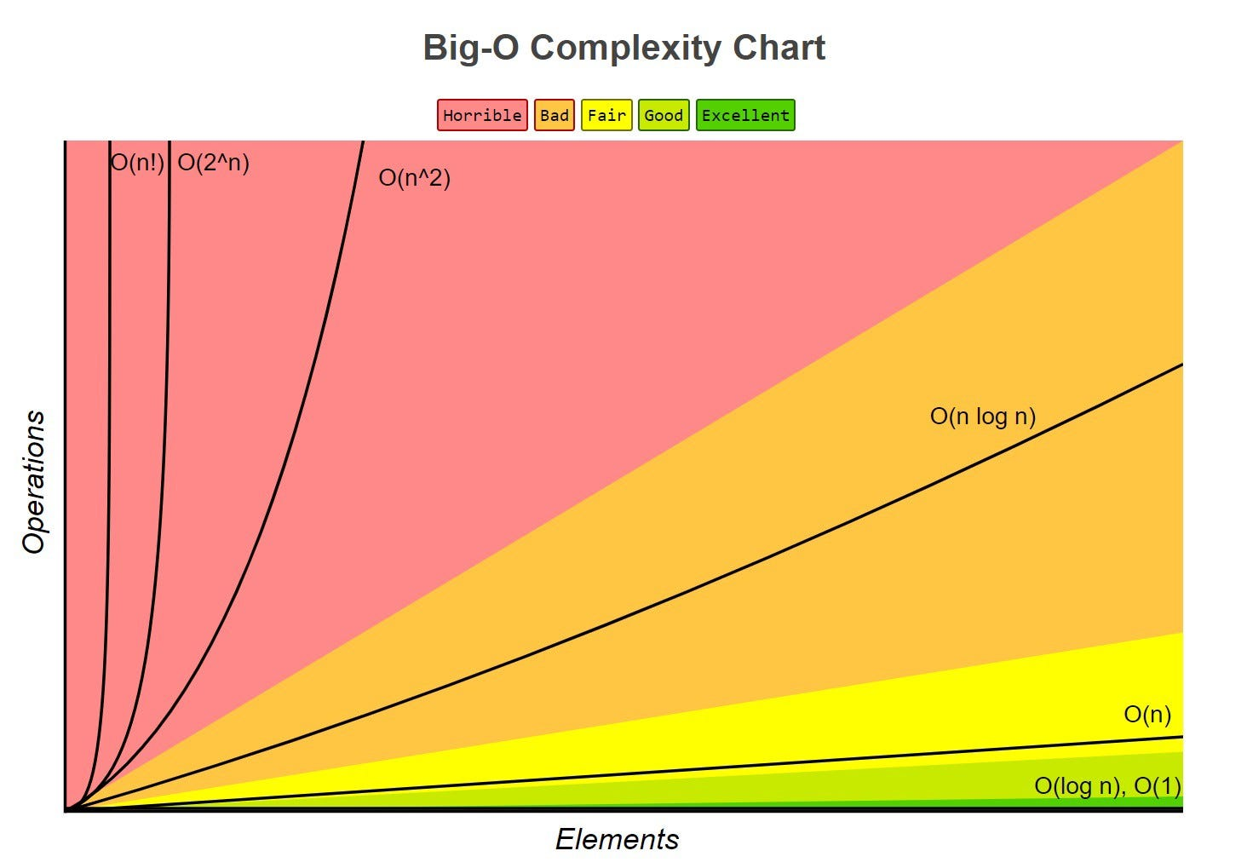
TIME COMPLEXITY

Slide 21
SPACE COMPLEXITY
Much less important, but still important is space complexity
In the code on the right, how many variables are ever created/used?
n = int(input("Enter a number")) for i in range(0, 5): sum = sum + i print(sum)

Slide 22
SPACE COMPLEXITY
How about in this code?
nums = [] n = int(input("Enter a number")) for i in range(0, n): nums.append(i) print(nums)

Slide 23
SPACE COMPLEXITY
Because a new variable is added to the list with each n, this algorithm is O(n) in terms of space efficiency and time efficiency
nums = [] n = int(input("Enter a number")) for i in range(0, n): nums.append(i) print(nums)

Slide 24
SPACE COMPLEXITY
Because computers have so much memory nowadays, this is much less of a problem
There are a handful of algorithms that use more space in exchange for shortening time
nums = [] n = int(input("Enter a number")) for i in range(0, n): nums.append(i) print(nums)

Slide 25
SELECTING ALGORITHMS
Small data sets – inefficient algorithms can be used without too much issue
Large data sets – time efficiency is key, such as O(log n), or O(n log n)
Real-time requirements – If a program needs to run very quickly, strive for O(1) or O(log n)
Complex problems – In many cases, a combination of algorithms is used where different parts can have different efficiencies

Slide 26
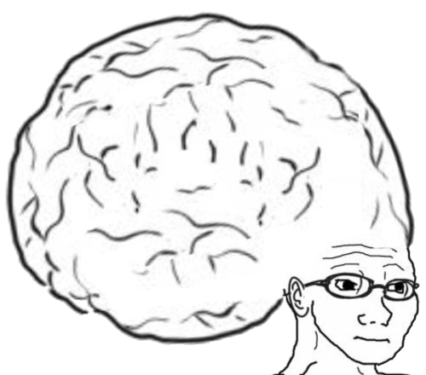
VOCAB TO REMEMBER
Time Efficiency
Space Efficiency
Big O Notation
Constant Time
Linear Time
Logarithmic Time
Quadratic Time
Exponential Time

Slide 27
WORKSHEET
Check the github repository for this class to find WS B2-1!
Good luck, and let me know if you need any help!

